Slide 1
ARTIFICIAL INTELLIGENCE
PROJECT :- AI IMAGE COLOURIZER USING OPENCV AND DEEP LEARNING

Slide 2
WHY AI IS AN IMPORTANT PART OF EVERYDAY LIFE?
Artificial Intelligence (AI) and its multiple sub-domains are being increasingly employed in various industries and businesses to aid in repetitive processes. But there has been a burgeoning interest from established tech giants and startups in using AI to make everyday life a walk in the park.
AI has been highly instrumental in optimizing the way we entertain ourselves, interact with our mobile devices, to even driving vehicles for us. We tend to encounter Machine Learning (ML) algorithms and Natural Language Processing (NLP) in several everyday tasks more than we know.

Slide 3
SOME APPLICATIONS OF AI IN EVERYDAY LIFE
AI and ML-powered software and devices are mimicking human thought patterns to facilitate the digital transformation of society. AI systems perceive their environment, deal with what they perceive, solve problems and act to help with tasks to make everyday life easier.
Some applications are as follows:-
Voice Assistants
Entertainment Streaming Apps
Personalized Marketing
Smart Input Keyboards
Navigation and Travel and many more……………..

Slide 4
AI IMAGE COLOURIZER AND ITS NEED IN TODAYS WORLD
Image colorization is the process of taking an input grayscale (black and white) image and then producing an output colorized image that represents the semantic colors and tones of the input (for example, an ocean on a clear sunny day must be plausibly “blue” — it can’t be colored “hot pink” by the model).
Previous methods for image colorization either:
Relied on significant human interaction and annotation
Produced desaturated colorization
The novel approach we are going to use here today instead relies on deep learning. We will utilize a Convolutional Neural Network capable of colorizing black and white images with results that can even “fool” humans!
This was done to revive many classic photographs, films and videos and make it more vivid and colourful for the human brain to remember better as visual learning is the best learning.

Slide 5
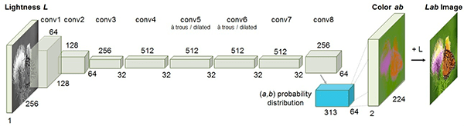
TECHNIQUE GoING ON BEHIND FOR COLOURISING

Slide 6
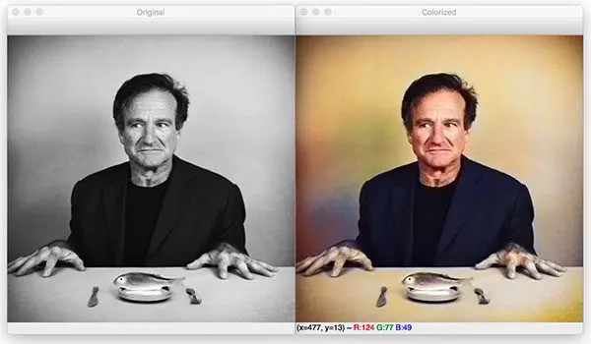
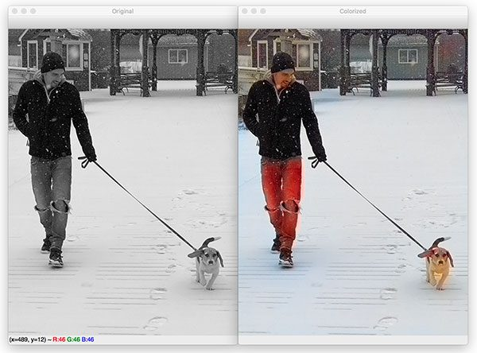
SOME EXAMPLES OF THE PROCESS WE USED

Slide 7
How can we colorize black and white images with deep learning?
The technique we’ll be covering here today is from Zhang et al.’s 2016 ECCV paper, Colorful Image Colorization.
Zhang et al. decided to attack the problem of image colorization by using Convolutional Neural Networks to “hallucinate” what an input grayscale image would look like when colorized.
To train the network Zhang et al. started with the ImageNet dataset and converted all images from the RGB color space to the Lab color space.
Similar to the RGB color space, the Lab color space has three channels. But unlike the RGB color space, Lab encodes color information differently:
The L channel encodes lightness intensity only
The a channel encodes green-red.
And the b channel encodes blue-yellow
Since the L channel encodes only the intensity, we can use the L channel as our grayscale input to the network.
From there the network must learn to predict the a and b channels. Given the input L channel and the predicted ab channels we can then form our final output image.

Slide 8
SUMMARY OF THE ABOVE PROCESS
Convert all training images from the RGB color space to the Lab color space.
Use the L channel as the input to the network and train the network to predict the ab channels.
Combine the input L channel with the predicted ab channels.
Convert the Lab image back to RGB.
To produce more plausible black and white image colorizations the authors also utilize a few additional techniques including mean annealing and a specialized loss function for color rebalancing

Slide 9
PROJECT STRUCTURE
Create the source code , models to be trained and the images to be colourized in a particular folder and open it using Jupyter notebook or Google Colab
use the tree command to inspect the project structure.
We have four sample black and white images in the images/ directory.
Our Caffe model and prototxt are inside the model/ directory along with the cluster points NumPy file.
We’ll be reviewing two scripts today:
bw2color_image.py
bw2color_video.py
The image script can process any black and white (also known as grayscale) image you pass in.
Our video script will either use your webcam or accept an input video file and then perform colorization.

Slide 10
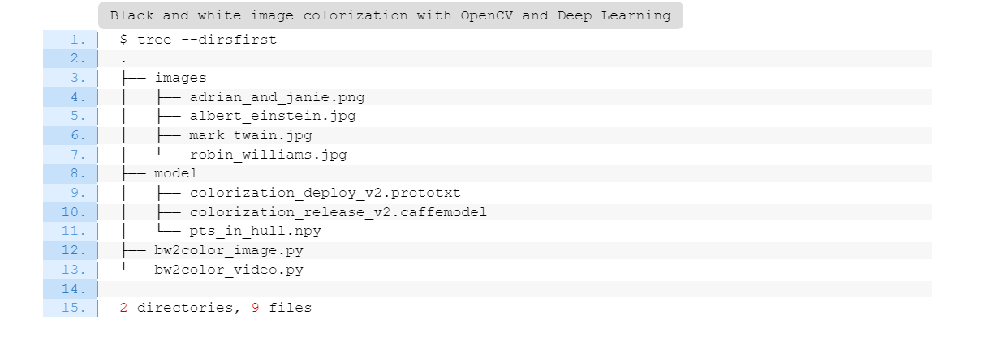
Project STRUCTURE (CONTD)

Slide 11
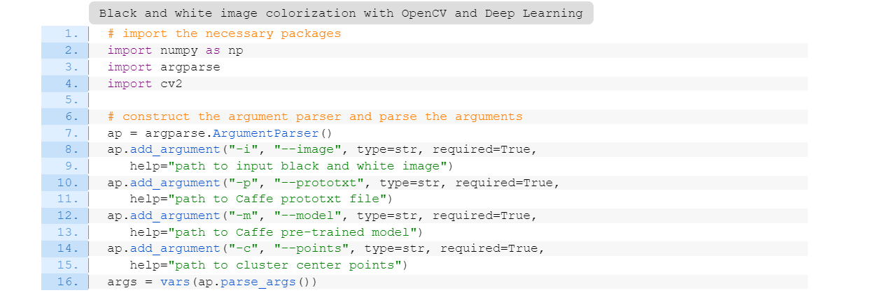
Colorizing black and white images with OpenCV
Let’s go ahead and implement black and white image colorization script with OpenCV.
Open up the bw2color_image.py file and insert the following code:

Slide 12
Our colorizer script only requires three imports: NumPy, OpenCV, and argparse
.
Let’s go ahead and use argparse to parse command line arguments. This script requires that these four arguments be passed to the script directly from the terminal:
--image
: The path to our input black/white image.
--prototxt
: Our path to the Caffe prototxt file.
--model
. Our path to the Caffe pre-trained model.
--points
: The path to a NumPy cluster center points file.

Slide 13
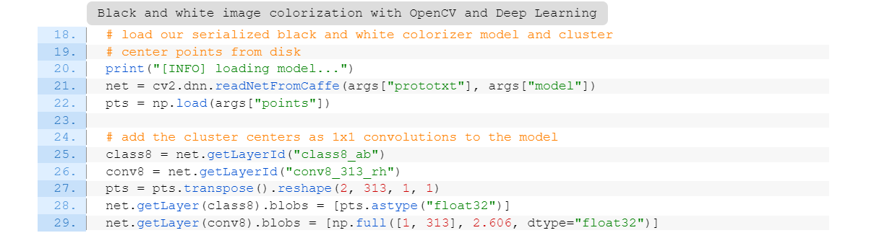
With the above four flags and corresponding arguments, the script will be able to run with different inputs without changing any code.
Let’s go ahead and load our model and cluster centers into memory:
Line 21 loads our Caffe model directly from the command line argument values. OpenCV can read Caffe models via the cv2.dnn.readNetFromCaffe function.
Line 22 then loads the cluster center points directly from the command line argument path to the points file. This file is in NumPy format so we’re using np.load.
Line 25-29 Load centers for ab channel quantization used for rebalancing.
Treat each of the points as 1×1 convolutions and add them to the model.

Slide 14
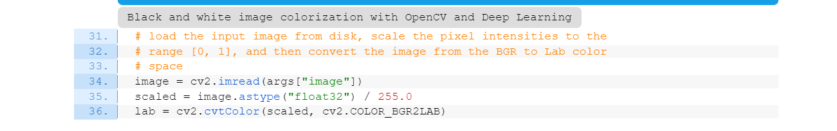
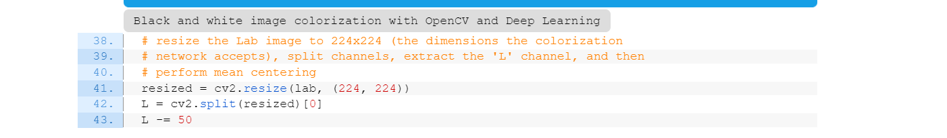
Now let’s load, scale, and convert our image:
To load our input image from the file path, we use cv2.imread on Line 34.
Preprocessing steps include:
Scaling pixel intensities to the range [0, 1] (Line 35).
Converting from BGR to Lab color space (Line 36).

Slide 15
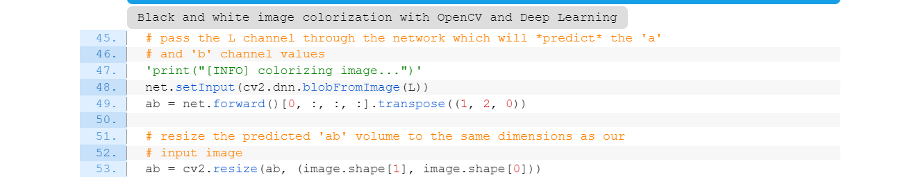
We’ll go ahead and resize the input image to 224×224 (Line 41), the required input dimensions for the network.
Then we grab the L channel only (i.e., the input) and perform mean subtraction (Lines 42 and 43).
Now we can pass the input L channel through the network to predict the ab channels:
A forward pass of the L channel through the network takes place on Lines 48 and 49
Notice that after we called net.forward , on the same line, we went ahead and extracted the predicted ab volume

Slide 16
POST PROCESSING OF IMAGE
Grabbing the L channel from the original input image (Line 58) and concatenating the original L channel and predicted ab
channels together forming colorized (Line 59).
Converting the colorized image from the Lab color space to RGB (Line 63).
Clipping any pixel intensities that fall outside the range [0, 1] (Line 64).
Bringing the pixel intensities back into the range [0, 255] (Line 69). During the preprocessing steps (Line 35) we divided by 255 and now we are multiplying by 255.
We’ve also found that this scaling and "uint8" conversion isn’t a requirement but that it helps the code work between OpenCV 3.4.x and 4.x versions.

Slide 17
PURPOSE OF THE PROJECT
AI Image colourisation using Open CV and Deep learning will reduce the painstaking task of colouring images using human annotations and other traditional techniques.
It will help us preserve many archival videos, photos etc in better quality which may have lost their quality due to not so good colouring techniques in the past.
It will also help us bring us life a lot of black and white images for better understanding etc.
Last but not least it will help us colourise personal photos of our forefathers for better display and preservation.

Slide 18
TEAM MEMBERS:-
Akshay Narisetti (RA1911003010684)
Parthib Ranjan Ray (RA1911003010664)
Pushkar Sinha (RA1911003010676)
Rohan Garodia (RA1911003010680)

